Slide 1
My Career So Far

Slide 2
Phases of my career so far
Phase I Science
Phase II Big-companies
Phase III Startup tech companies
Phase IV Interruption
Phase V Tech-related non-profits
Phase VI Academics

Slide 3



Phase I – Science (12 years)
Started programming in earnest 58 years ago at age 16
B.A., M.S., & Ph.D. in chemistry (10 years)
Chose chemistry over computer science for grad school for no good reason
Post-Doc at Bell Labs (2 years)
Helped invent the field of computational chemistry
One of my more cited research papers is on numerical methods for simulating infrequent events

Slide 4



Phase II – Big company tech (20 years)
Engineer & engineering manager at Bell Labs (10 years)
Divestiture planning
Supervisor of Nuclear Weapons Effects Group
Supervisor of Robust Network Planning Group
Head of Government Communications Systems Department
Defense Nuclear Agency (DNA)
Federal Aviation Agency (FAA)
National Security Agency (NSA)
Another three-letter-agency
Business side of AT&T (8 years)
Software product management
Internet strategist – helped lead the privatization of the Internet
Managed Dun & Bradstreet’s global infrastructure (2 years)

Slide 5
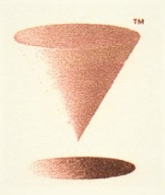



Phase III – Startup tech (11 years)
Chief Technology Officer
The Redtop Company
Electronic medical records for psychiatry
Declared bankruptcy
Cometa Networks
Wholesale Wi-Fi
Founded by IBM, AT&T, and Intel
Failed, but shut down gracefully
Send Word Now
Critical communications and alerting
Sold for over $200M in 2017
Advisor (2013-2014)
Rigetti Computing (quantum computing)
Went public in 2022 via a SPAC
Pre-money valuation of $1.04B, current valuation ~ $0.16B

Slide 6


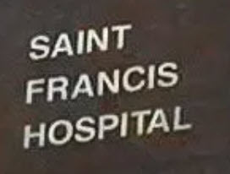

Phase IV – Interruption (1 year)

Slide 7



Phase V – Tech-related non-profits (7 years)
CEO & President of tech-related non-profits
New York Technology Council (NYTECH)
NY Tech Alliance (NYTA)

Slide 8

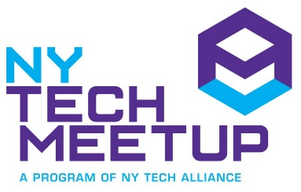
NY Tech Meetup
The first and largest meetup on Meetup.com

Slide 9



Phase VI – Academics (12 years so far)
CUNY
School of Professional Studies (SPS)
Adjunct (5 years)
M.S. in Data Science
B.S. in Information Systems
Faculty advisor
The City College of New York (CCNY)
Adjunct (1¹/₂ years)
Machine Learning & Scientific Computing
Full-time regular faculty (5½ years)
Artificial Intelligence
Machine Learning
Scientific Computing
Senior Project on Modeling and Analysis of Complex Systems
NYU Tandon (1 year)
Developed online graduate course in Machine Learning for Bioinformatics

Slide 10
Advisory Panels and Boards
CUNY Tech Prep, Board of Advisors (2019-present)
NY Tech Foundation, Board of Directors (2019-2021).
NY Tech Alliance (NYTA), Board of Directors (2018-2021)
New York Maritime Innovation Center (NYMIC), Board of Advisors (2018-2019).
New York Technology Council (NYTECH), Board of Directors, Chairman, (2010-2012), Vice-Chairman (2012-2013), Member (2014-2016).
Technology Councils of North America (TECNA), Board of Directors (2014)
New York Software Industry Association (NYSIA), Board of Directors (2003-2009); CTO Council, co-chair.
Information Industry Association (IIA), Board of Directors (1996-1998).
National Information Infrastructure Testbed (NIIT), Board of Directors and Treasurer (1993-1995).
White House Science Office, Counter-Terrorism Technology Oversight Panel (1987-1989).
National Academy of Sciences (NAS), National Research Council (NRC), Committee on Review of Switching, Synchronization, and Network Control in National Security Telecommunications (1986-1989).
National Security Telecommunications Advisory Committee (NSTAC), Electromagnetic Pulse Task Force (1983-1985).
Tech
in NYC
Internet
National Security

Slide 11
Some People in Tech with whom I’ve worked (or just knew or met)

Slide 12
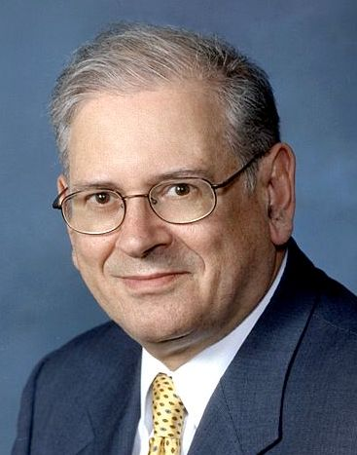
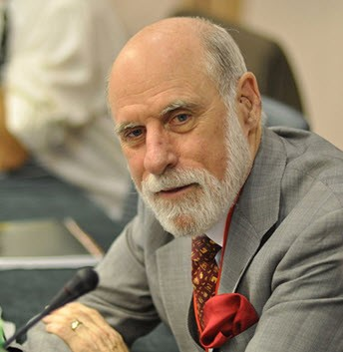
Turing Awardees with whom I’ve worked
Bob Kahn
Vint Cerf
1938-
BEE, CCNY 1960
1943-
Led the ARPANET project
Developed the TCP/IP protocol
from: ACM.org

Slide 13
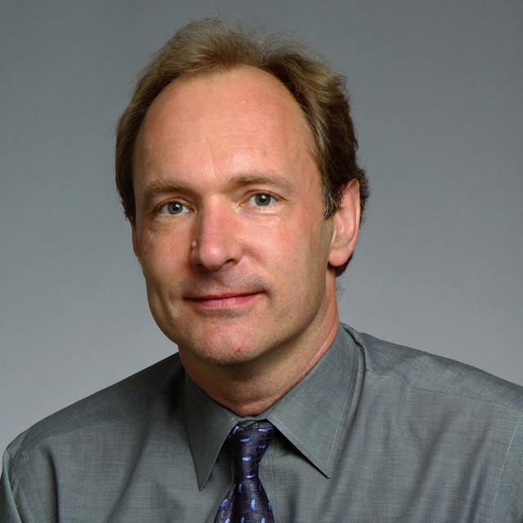
A Turing Awardee who I offered a job
Tim Berners Lee
1955-
Invented the World Wide Web, the first web browser, and the fundamental protocols and algorithms that allowed the Web to scale.
from: ACM.org

Slide 14
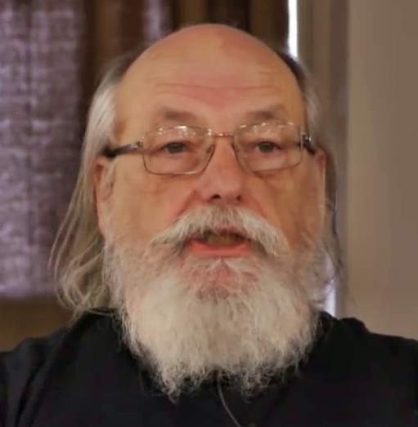
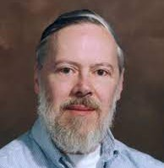
Turing Awardees whom I knew
Ken Thompson
Dennis Ritchie
1943-
1941-2011
Designed and implemented the original UNIX operating system
Invented the B programming language
Led the development of the Plan 9 distributed operating system
Co-created UNIX and B
Created the C programming language
Worked on Plan 9
from: Wikipedia

Slide 15
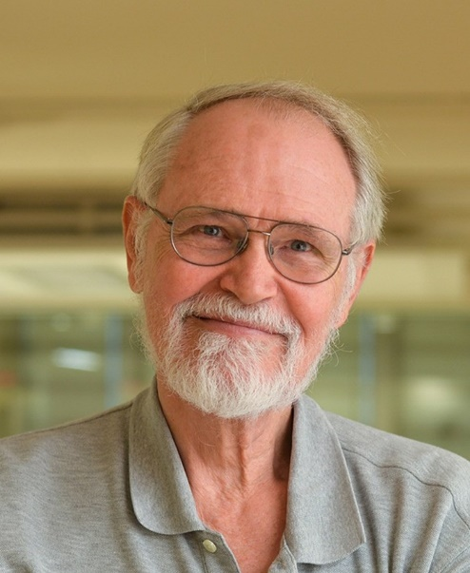
Another Bell Labs colleague you may know of
Brian Kernighan
1942-
Co-authored, with Dennis Ritchie, The C Programming Language.
Authored many UNIX programs including AWK and AMPL
Developed well-known heuristics for two NP-complete optimization problems: graph partitioning and the traveling salesperson problem.
Teaches, among other topics, Computer Science for humanities and social science students
from: Wikipedia

Slide 16
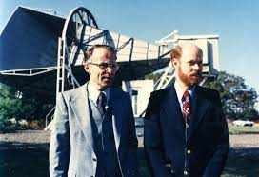
Nobel laureates with whom I’ve worked
Arno Penzias
Robert Wilson
1933-
1936-
Discovered the comic microwave background radiation which helped establish the Big Bang theory of cosmology.
from: Wikipedia

Slide 17
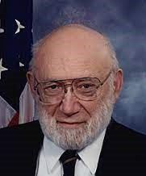
A Nobel laureate who chaired the White House Science Office, Counter-Terrorism Technology Oversight Panel
Joshua Lederberg
1925-2008
Awarded the 1958 Nobel Prize in Physiology or Medicine at the age of 33 for his discovery that bacteria can mate and exchange genes
President, Rockefeller University

Slide 18
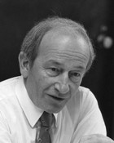
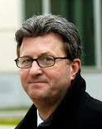
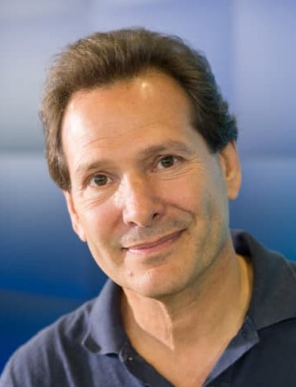
Three of my bosses at AT&T
Sol Buchsbaum
Joe Nachio
Dan Schulman
1929-1993
1949-
1958-
White House Science Advisor to Nixon, Ford, Carter, Reagan, H.W. Bush
Strategic Defense Initiative (aka Star Wars)
Turned down my recommendation to offer Internet services in 1991
CEO Qwest Communications
Wouldn’t give customer data to the NSA
Served 4+ years for insider trading
CEO Priceline
CEO Virgin Mobile USA
CEO PayPal

Slide 19
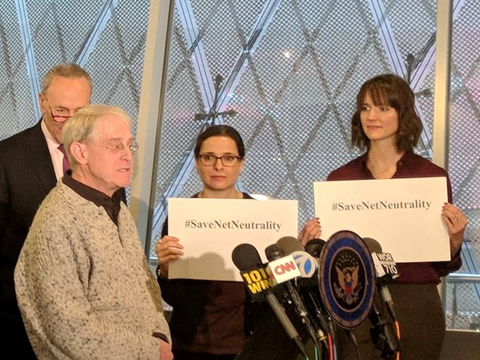
Speaking on behalf of Net Neutrality
A press conference held on Net Neutrality by Senator Chuck Schumer in 2017

Slide 20
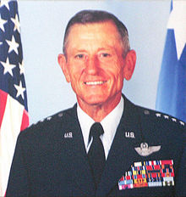
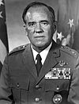
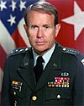
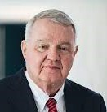
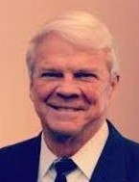
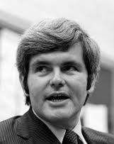
Policy influencers/makers to whom I’ve presented
Gen Bennie Davis
Gen James Hartinger
Lt Gen Lawrence Skibbie
Strategic Air Command
North American Aerospace Defense Command
Army Communications Command
James Burnley IV
T. Allan McArtor
Newt Gingrich
Secretary of
Transportation
Federal Aviation Agency
Administrator
US Representative

Slide 21
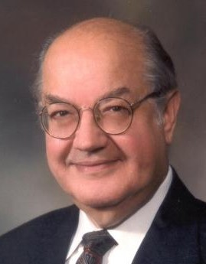
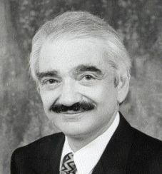
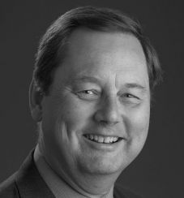
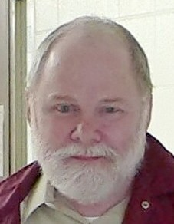
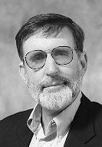
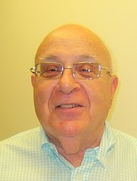
Origins of the Internet
Paul Baran
Howard Frank
Bob Kahn
Vint Cerf
Packet Switching
ARPAnet
architecture
ARPAnet
TCP/IP
Paul Mockapetris
David Mills
Larry Landweber
Dave Farber
DNS
NTP
CSNET
Adoption of TCP/IP
SNOBOL
CSNET
NSFNet
NREN

Slide 22
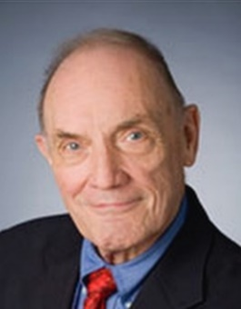
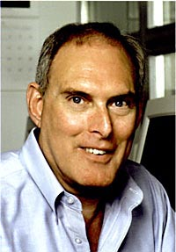
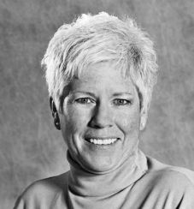
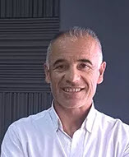
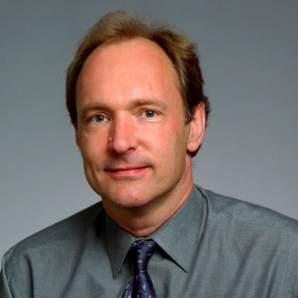
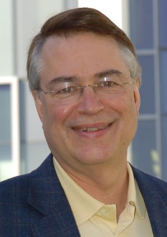
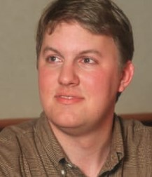
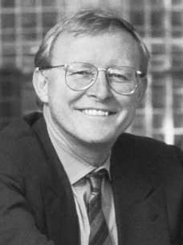
Evolution of the Internet
Steve Wolff
Sid Karin
Susan Estrada
Sergio Hecker
NSFNET
SDSC @ UCSD
BME CCNY
CERFnet
JVNCnet
Tim Berners-Lee
Larry Smarr
Mark Andreessen*
Jim Clark*
World Wide Web
NCSA @ UI-UC
NCSA @ UI-UC
Netscape
Andreessen Horowitz
Silicon Graphics
Netscape
WebMD

Slide 23
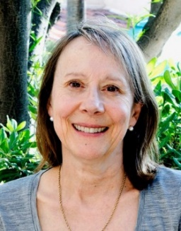
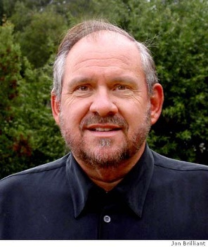
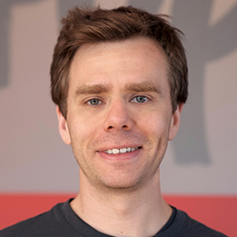
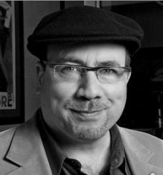
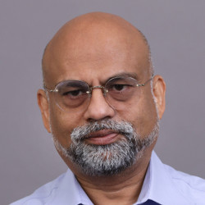
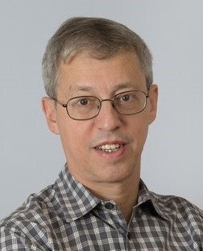
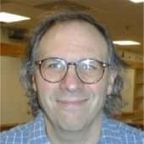
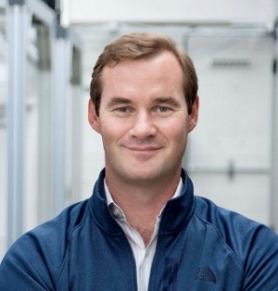
More tech people I know
Ester Dyson
Larry Brilliant
Scott Heiferman
Craig Newmark*
ED Venture
Release 2.0
Investor
NY Tech Meetup
Meetup.com
Craigslist
Jerry Garcia’s MD
WHO (smallpox)
Cometa Networks
Google Foundation
Bud Mishra
Stuart Haber
Larry Rudolph
Chad Rigetti
Computer Science
Mathematics
Engineering
Cell Biology
Blockchain
ReDigi
IBM QC
Rigetti Computing

Slide 24
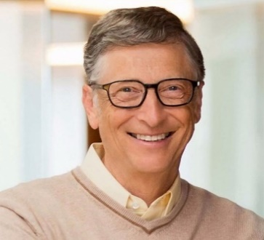
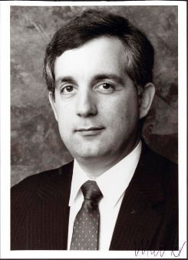
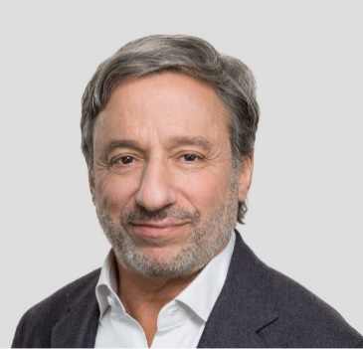
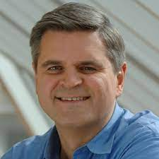
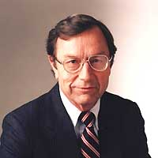
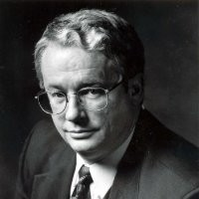
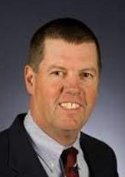

Tech people I’ve met
Steve Case*
Bill Gates*
Mitch Kapor
Jim Manzi
AOL
Microsoft
Lotus
EFF
Lotus
Ray Noorda
Bob Frankenberg
Scott McNealy*
John Sculley
Novell
Novell
Sun Microsystems
Pepsi
Apple

Slide 25



NYC-based startup funding
Brad Burnham*
David Rose
Brian S. Cohen
AT&T Ventures
Union Square Ventures
NY Angels
Gust
NY Angels
NY Venture Partners
Science Literacy Foundation

Slide 26






Policy influencers/makers
Andrew Rasiej
John Perry Barlow
Michael Bloomberg*
NY Tech Meetup
Personal Democracy Forum
Civic Hall
Grateful Dead lyricist
EFF
Internet Manifesto (1996)
Bloomberg LP
NYC Mayor
Bill de Blasio
Al Gore
Chuck Schumer
NYC Mayor
Tech Talent Pipeline
CUNY 2X Tech
US Senator
Vice President
US Senator

Slide 27
What you can expect as a computer scientist
Data from the CCNY CUNY 2X Tech Program
Reported starting salary (2021-2022)
Mean $106,661
Range from $60,000 to $270,000
Hiring companies included
Accenture
American Express
Bank of America
Blackstone
Goldman Sachs
IBM
NBC Universal
Stripe
The New York Times
Twitter

Slide 28
Comments relevant to your careers
The U.S. economy will go up and down
Individual companies will go up and down
NYC will remain a center of innovation
NYC will become an increasingly important tech hub because of its talent and its culture of innovation
You will need to always be learning
Your personal network will be very important

